Slide 1
BEST-FIRST SEARCH

Slide 2
BEST FIRST SEARCH
It is a combination of breadth-first search and depth first search.
In every step, the most promising node based on some heuristic function is selected.
The node is then expanded to generate the successors.
Depth-first search of the most promising node takes place and if at any node the solution is not obtained, then go back to the node which have been expanded and check for the other more promising node( i.e it takes the form of a breadth-first search).

Slide 3
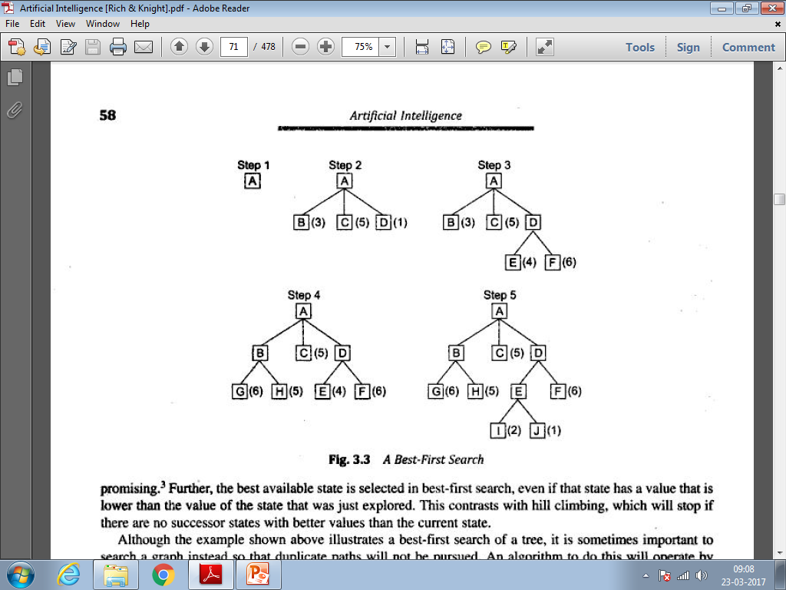
BEST-FIRST SEARCH contd…

Slide 4
OR graph
Each node will contain the description of the problem state it represents, an indication of how promising it is , a parent link to recover the path to the goal once the goal is found.

Slide 5
LIST OF NODES
OPEN:
Contain nodes which have been generated and a heuristic function has been applied on them, but they have not been tested(examined). It is a priority queue.
CLOSED:
Contains nodes that have been examined.
A heuristic function f’=g’(cost of going from one node to another node)+h’(estimated cost from the goal state).

Slide 6
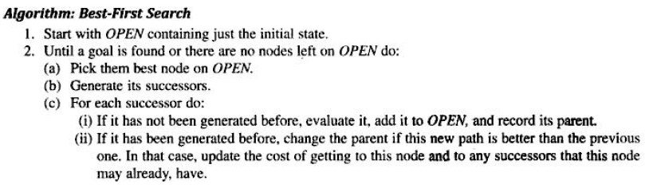
Algorithm

Slide 7
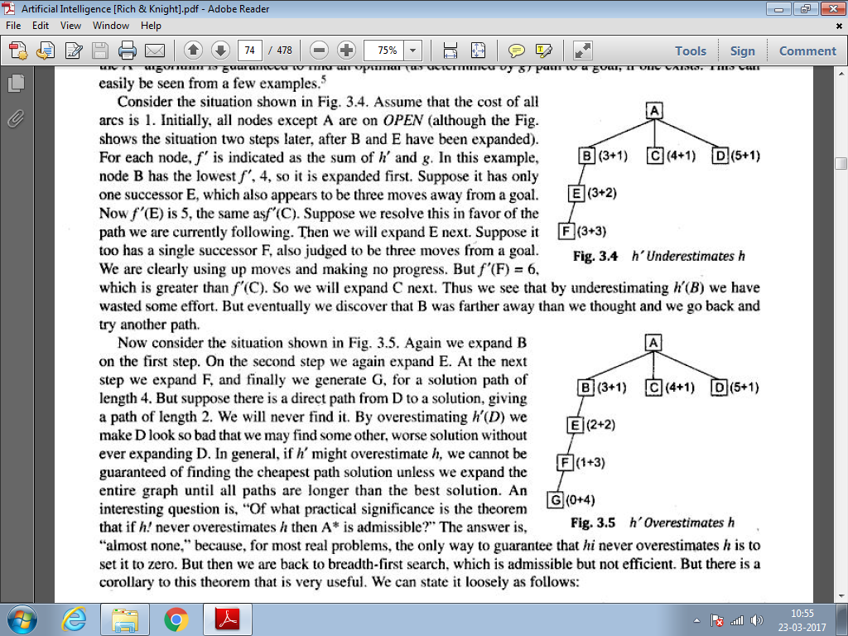

A* algorithm
H’ is a perfect estimator of h

